Slide 1
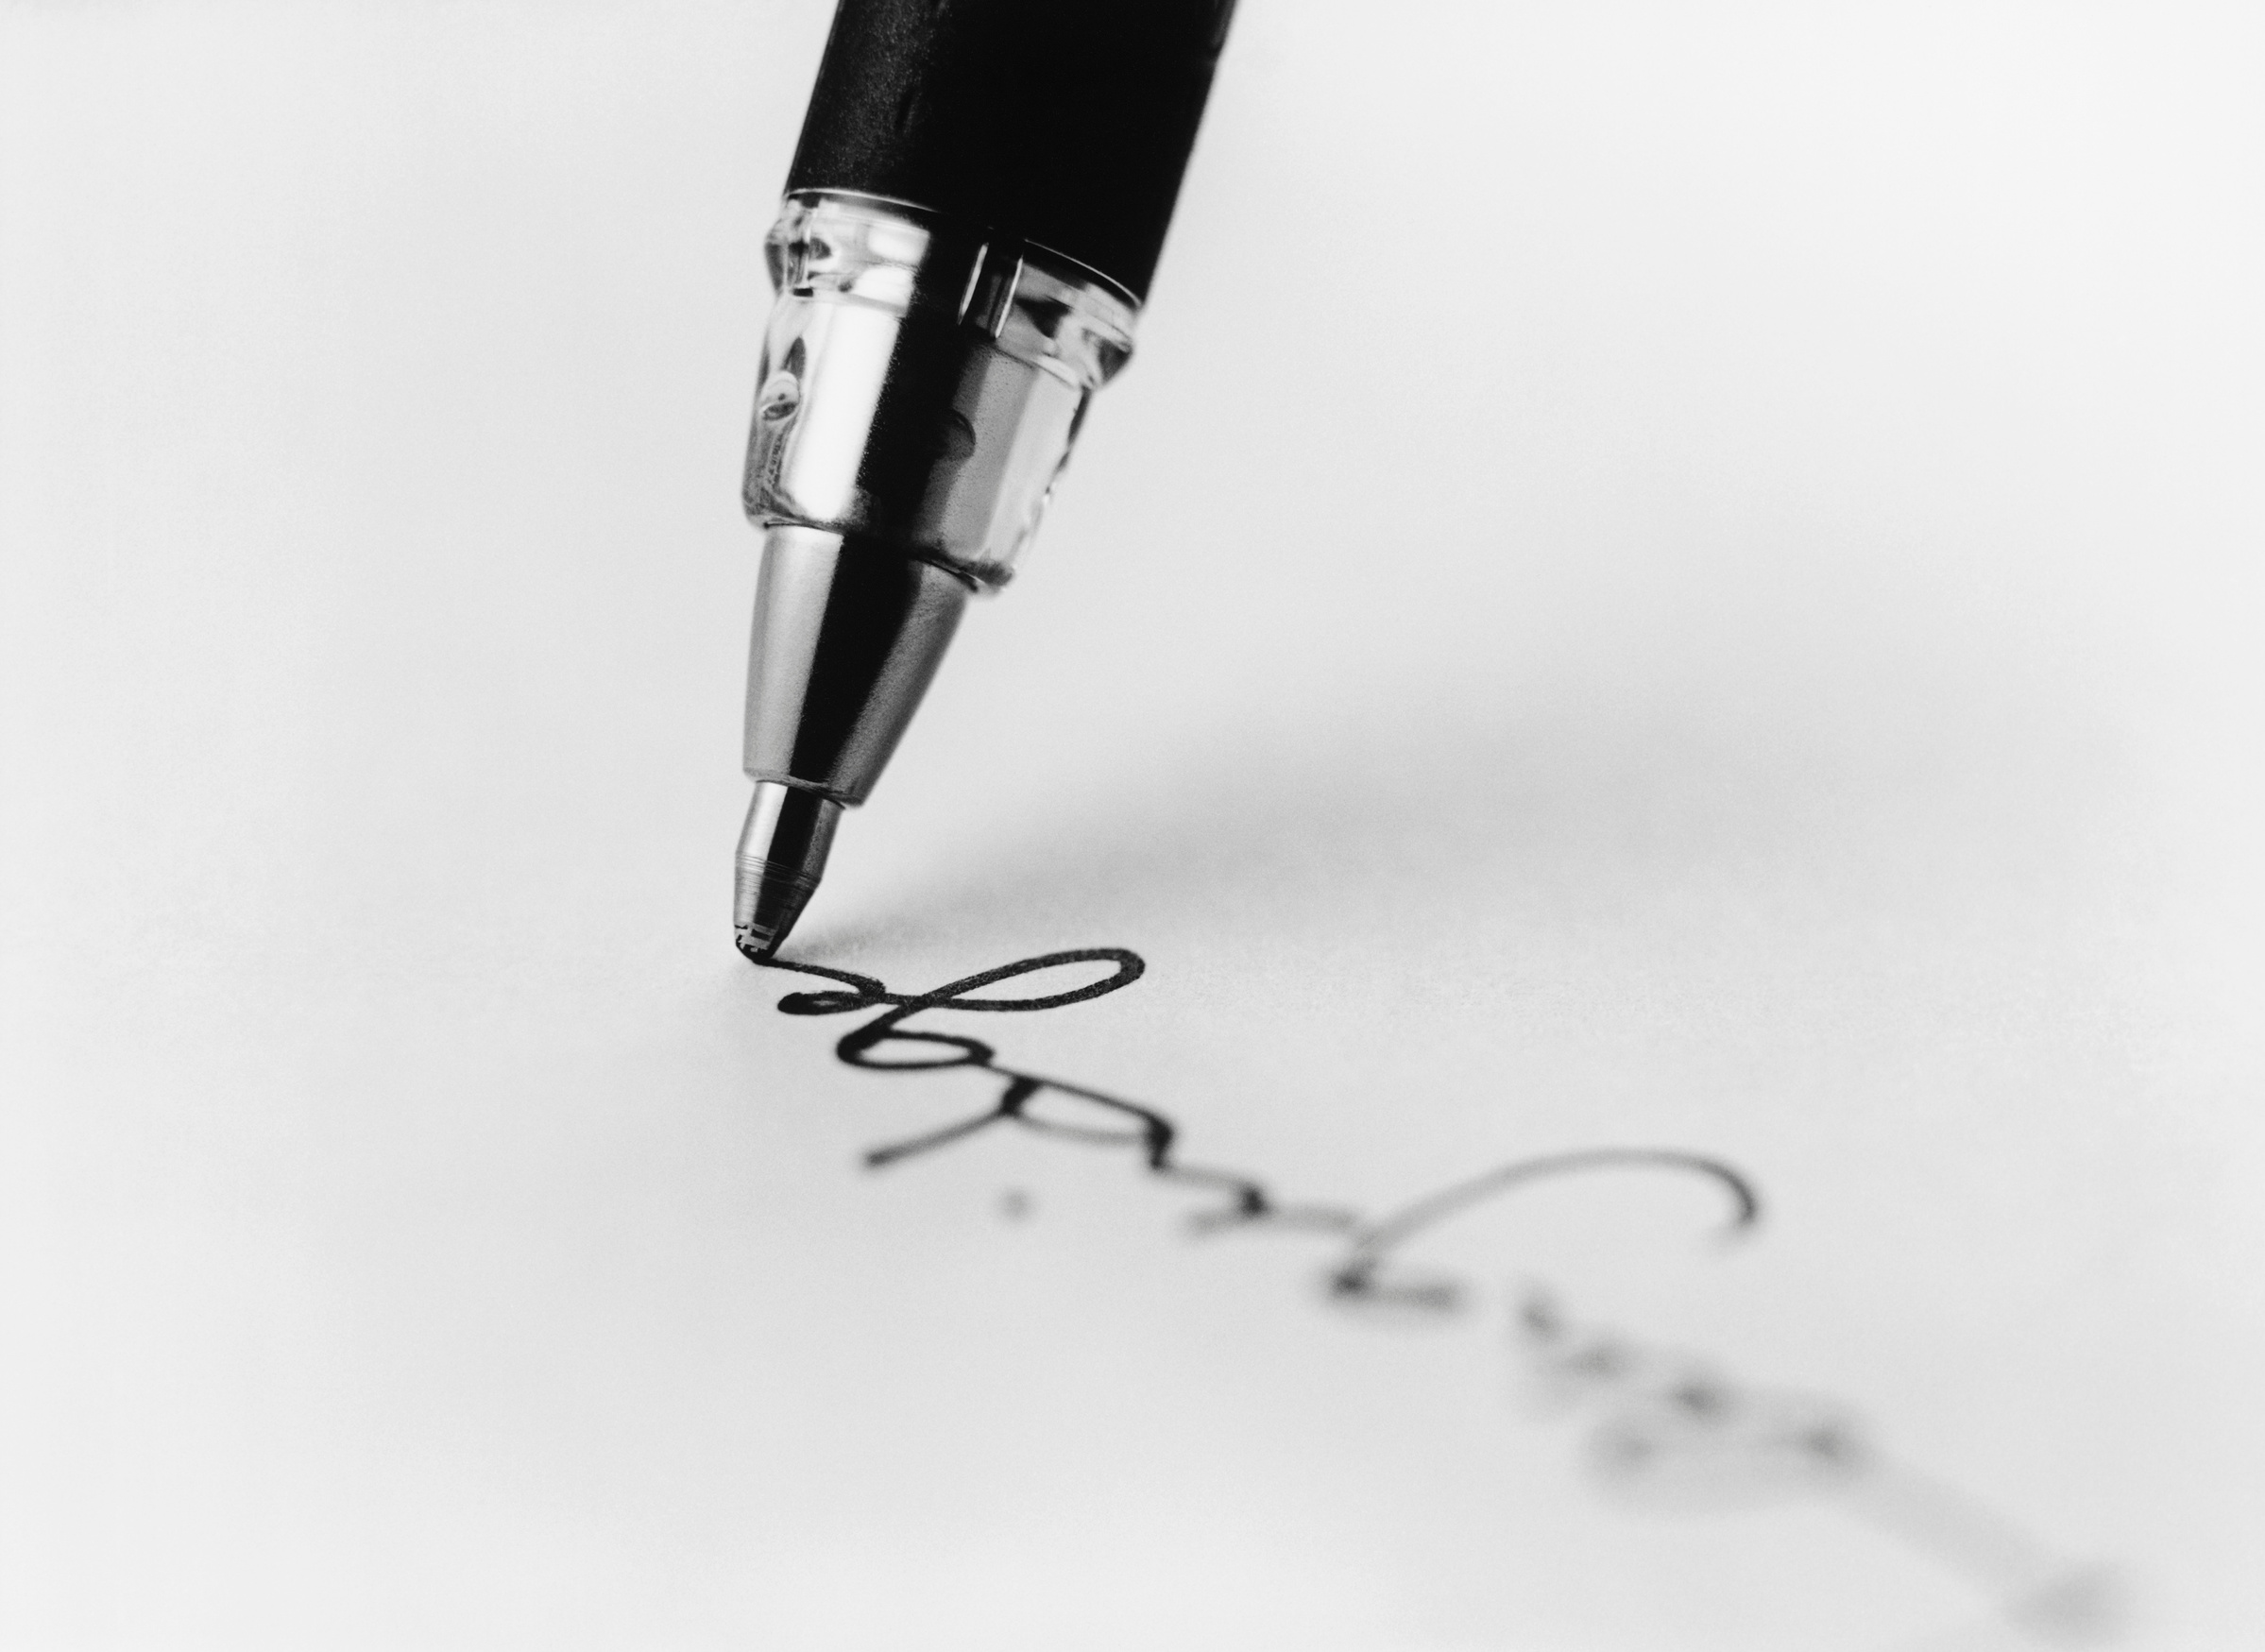

Signature Verification
System
1.The Problem:
Places like government offices, courts, and banks rely on signatures for authentication, but forgeries are a major issue, leading to fraud and disputes.
2.The Solution:
Our Signature Verification System uses advanced deep learning models to verify signatures accurately, automating the process and enhancing security.
3.Impact:
This system helps government offices, courts, and banks prevent fraud, protect assets, and ensure trust.

Slide 2
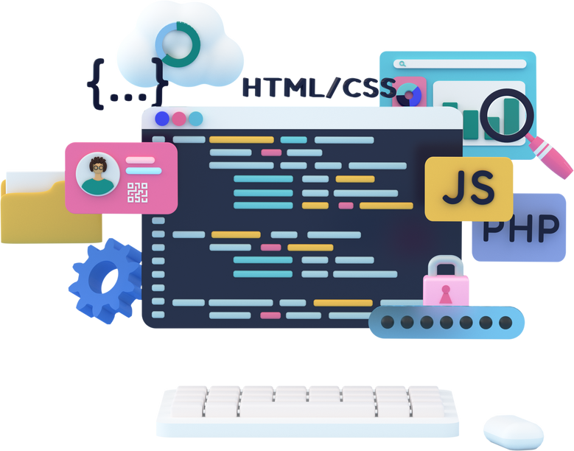


Technical
Stack
Github
Frontend
Backend
GitHub is a platform for hosting and collaborating on code, enabling version control and collaborative software development using Git.
For designing the user interface, ensuring smooth navigation and user-friendly interaction using HTML ,CSS and Java Script
Deep Learning
Manages the backend logic, user authentication, and routing.
Handles file uploads and communicates with the deep learning models for predictions.
Deep learning architectures like CRNN, Bi-RNN, and RNN are utilized to analyze sequential and spatial features in signatures,LSTM for Processing image and openCV

Slide 3

Deep Learning Model
1
RNN is a neural network designed to process sequential data by using feedback loops to capture temporal dependencies.
2
A Bi-RNN processes data in both forward and backward directions, capturing context from both past and future inputs.
CRNN combines convolutional layers for feature extraction and recurrent layers for sequence modeling, making it ideal for tasks like signature verification.
3

Slide 4
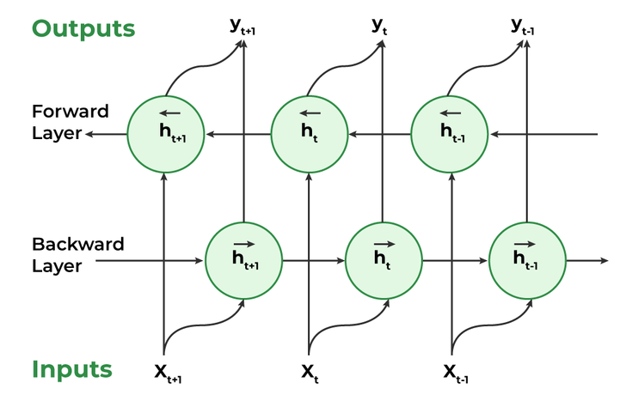
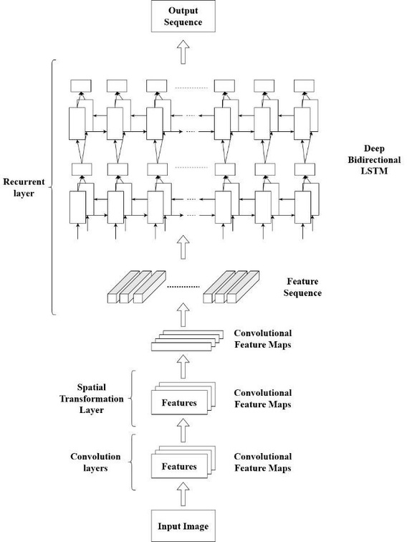
Architecture
BI-RNN
CRNN
RNN
L
L
t-0
L
t
L
t+1
w
>
>
>
>
unfold
w
w
w
v
h
...
>
h
>
h
>
h
>
. . .
>
>
v
t-1
v
t
v
t+1
v
u
>
>
>
x
u
u
u
X
t-1
X
t
X
t+1

Slide 5
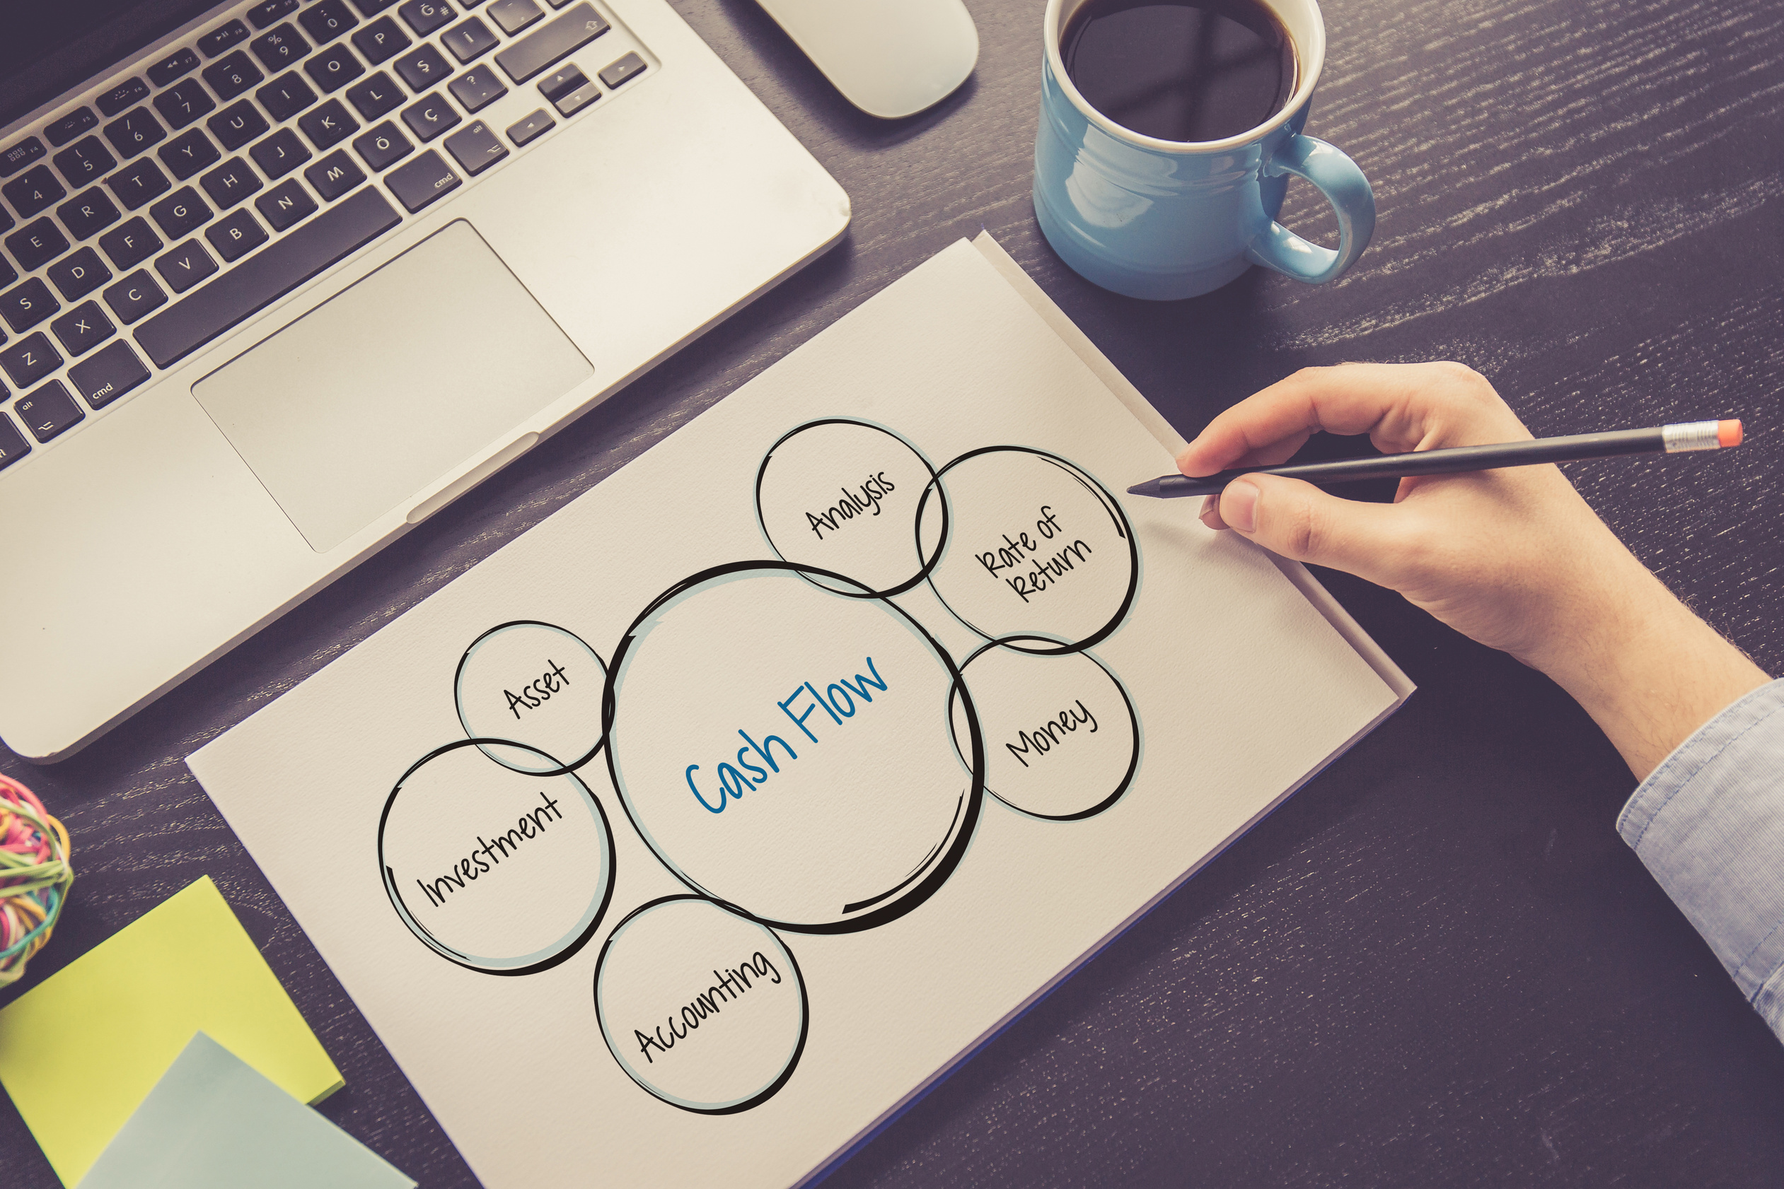
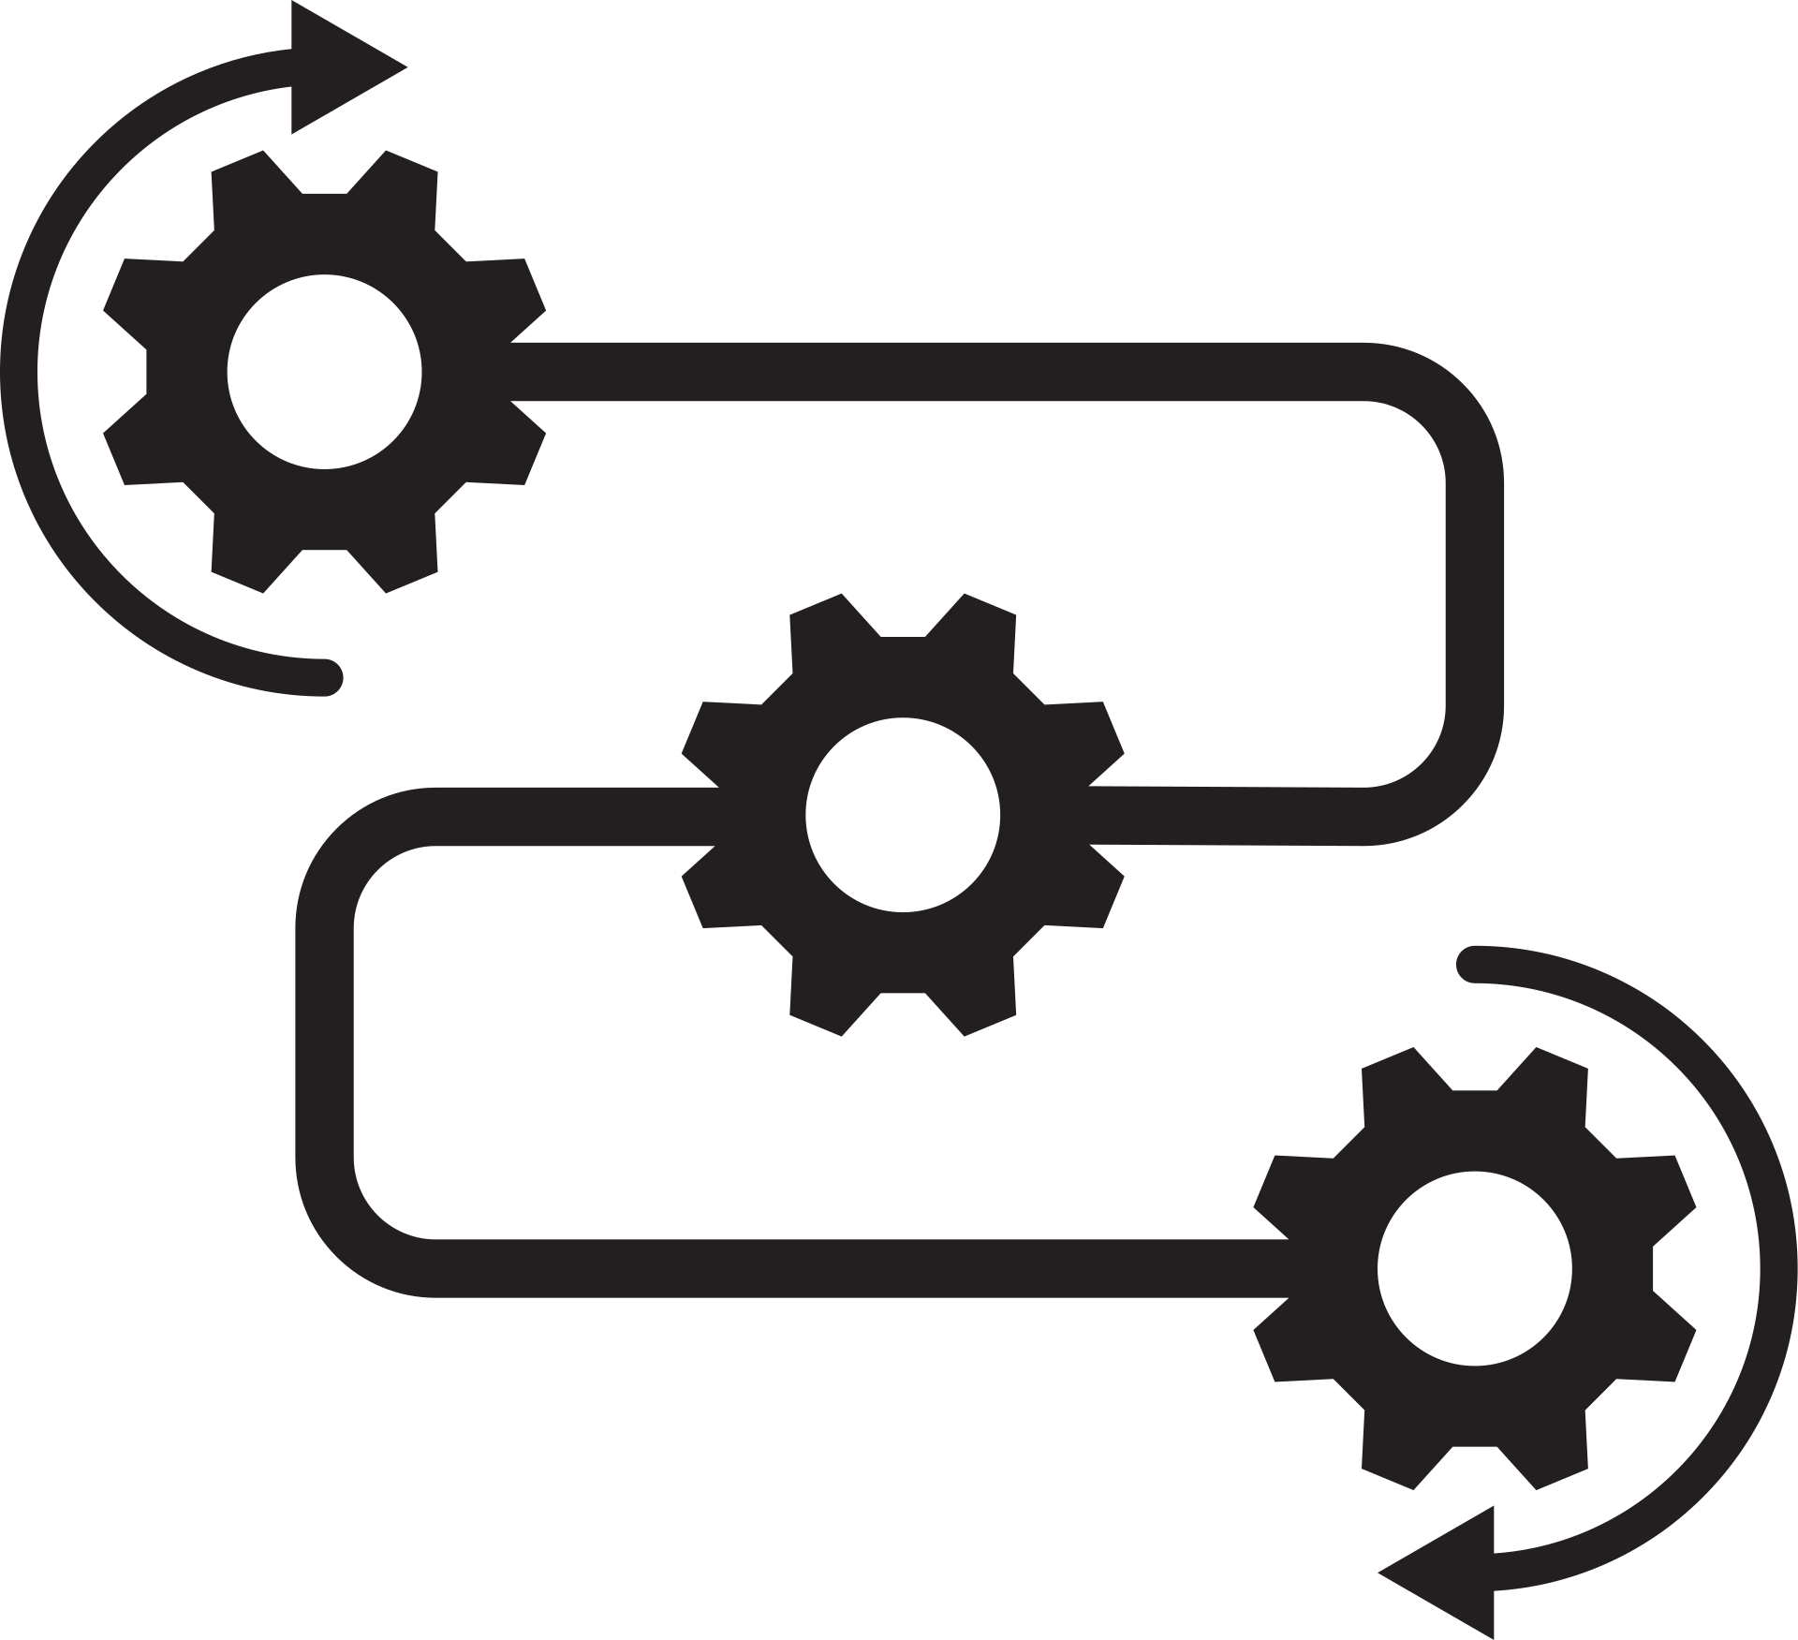
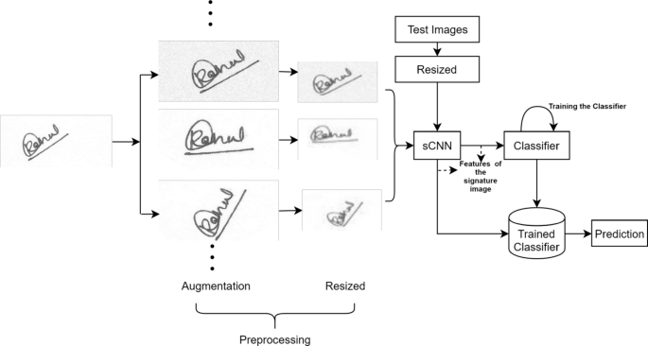
Work Flow

Slide 6
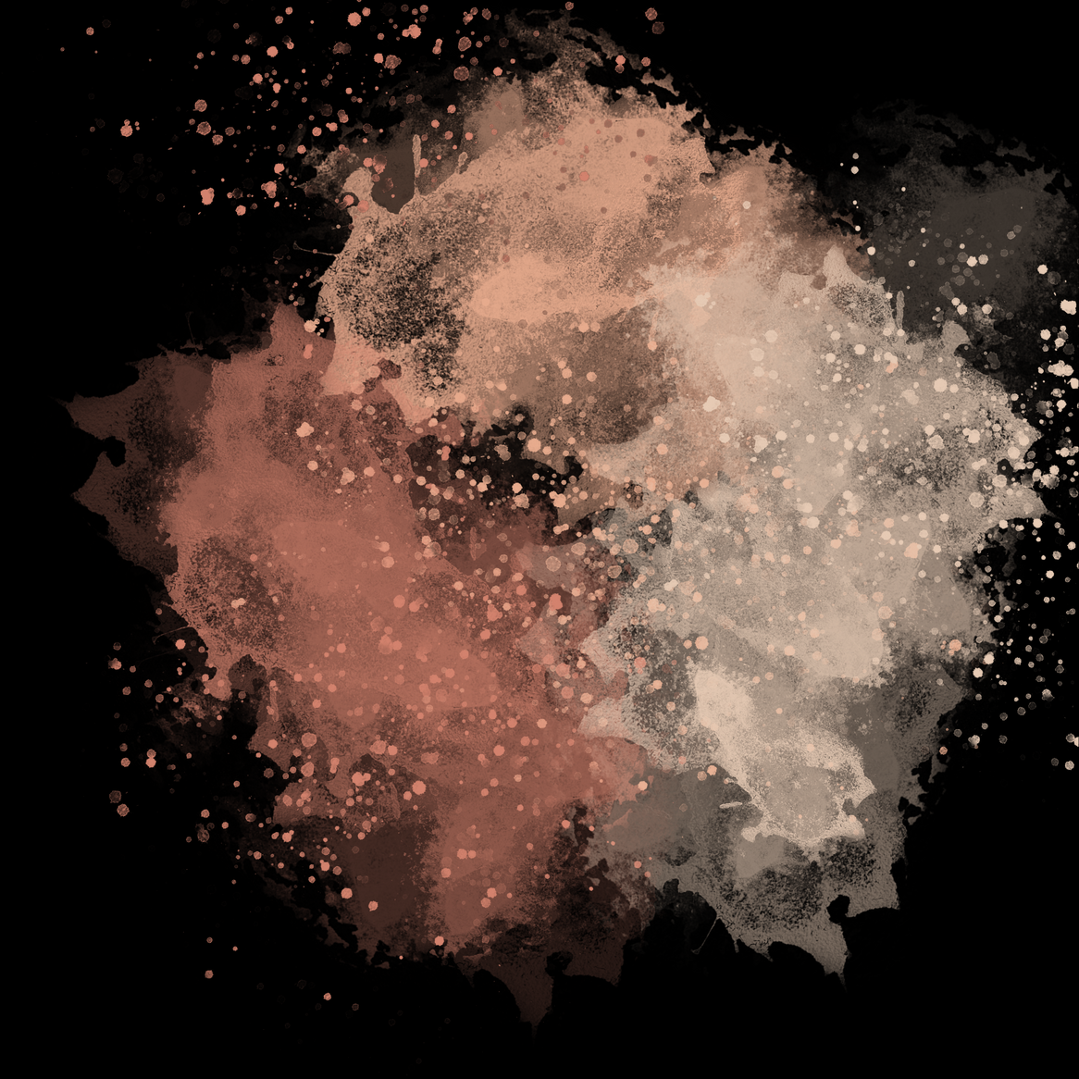
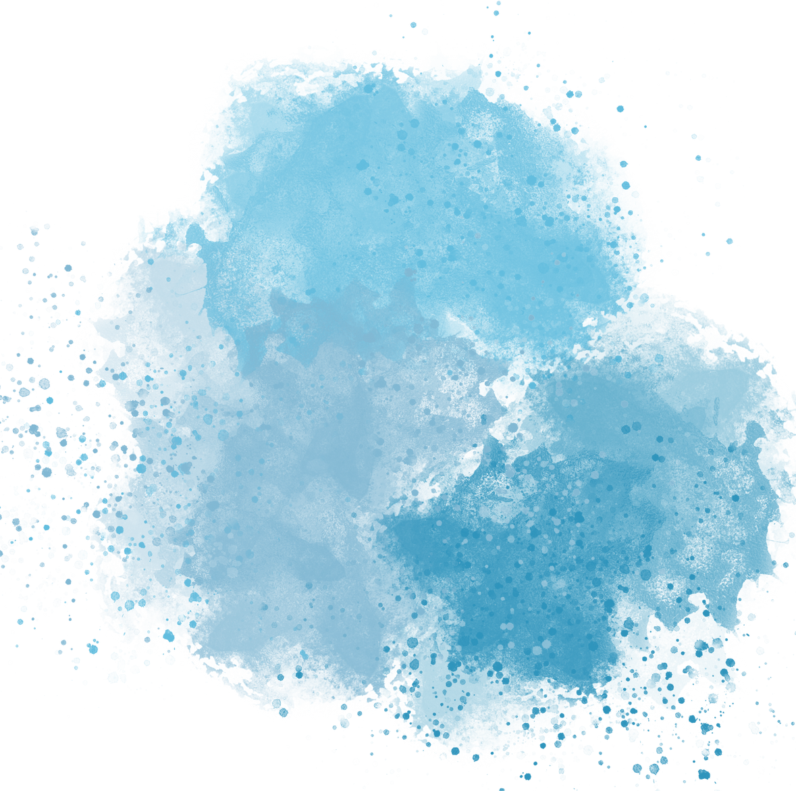

Result
Objective: Develop a deep learning-based system to automatically classify handwritten signatures as Genuine or Forged.
Dataset: Signature images labeled as Genuine or Forged, preprocessed to 256x256 pixels and grayscale for model training.
Models Used: Trained models include Bi-RNN, CRNN, and RNN for accurate signature classification.
Approach: The system uses deep learning to extract features from signature images and predicts authenticity.
Application: The system can be used for fraud prevention, identity verification, and document authentication.

Slide 7



